Slide 1
Camera Nano: Pedestrian Detection Team Project Demo
Bharath Ramachandraiah
Nicolas Ojeda Leon
Sameera B Chilmattur
Sandeep Raju
IMSEIT, H-DA
22-July-2019

Slide 2
Agenda
Goal of the project
Approach taken
Technical details
Future extensions

Slide 3
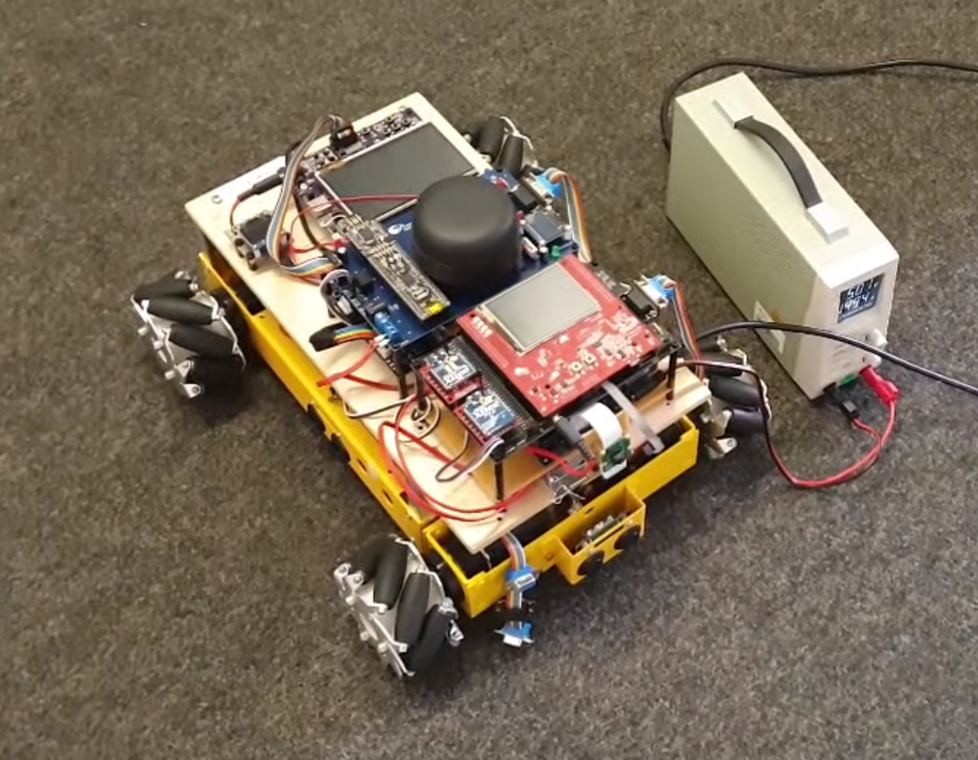
Background
Student Car

Slide 4
Project Goals
Pedestrian Detection Hardware Platform with Future Focus
Single Pedestrian Detection – A step in the door approach
Scalable Thread based Development
Non-Intrusive Feature Addition to Existing Platforms
Common Interfacing

Slide 5
Prepare Phase Accomplishments
Study of Algorithms
Analysis of Hardware Platforms
Redefining of Goals
Effort Estimation, Expert Review

Slide 6
Component Interface Design
LiDAR
CAN
Gateway
UART
Camera-Nano
Common interface for both CameraNano and MAZE camera's
More features can be added in AURIX app / Nano in future
No design impact for camera change and multiple cameras addition
CAN
AntiCollision
UART
CAN
AURIX

Slide 7
Hardware
Nvidia Jetson Nano
Quad Core ARM Cortex A57 at 1.43GHz
4GB LPDDR4
128 core Maxwell GPU
Upto 8 Camera connections
Latest Linux LTS Distribution - Ubuntu
OpenCV optimized for the hardware

Slide 8
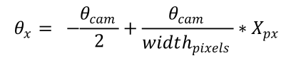
Component Description: CameraNano Application
Functionality
Nano obtains camera feed at 30 FPS
Runs OpenCV-HOG based detection Algorithms
Detects any Pedestrian in the Camera’s FOV
Filter the false positives
Compute the angle of location of the Pedestrian from Pixel value
Delta angle of the Pedestrian
0⁰
Theta
Delta Theta

Slide 9
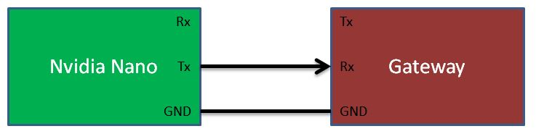
Component Description: CameraNano Application
Interface to the system
NVidia board is connected to Gateway via UART
Transmits the detected information
Theta
Delta Theta

Slide 10
Component Description: CameraNano Application
Implementation
Single process - 5 threads application
Detection
Camera Service
Communication Tx Service
Communication Rx Service
Background
Components
MailBoxes
Resources
Camera
UART
Mutex, Semaphore

Slide 11
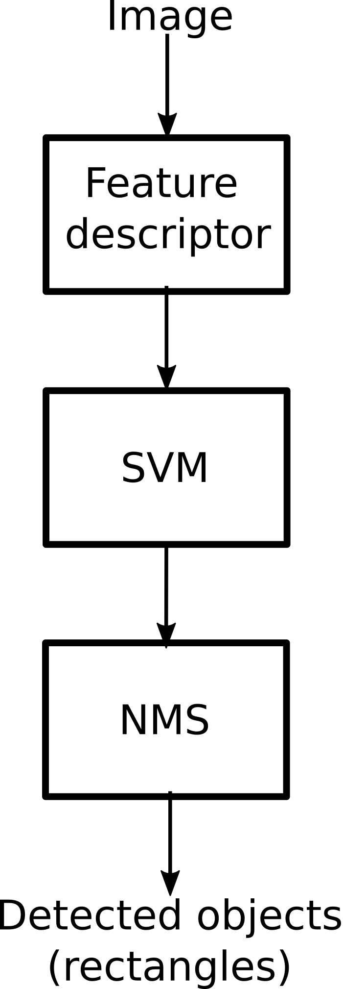
Component Description: CameraNano Algorithm
Feature descriptor (HOG)
Useful to stand out edges - Shape information
Normalization to reduce illumination and contrast differences.
Pixel patches for compact information and noise immunity.
Single numerical vector output
Support Vector Machine (SVM)
Trained decision model
Non maximum suppression (NMS)
Merging several overlapping detections

Slide 12
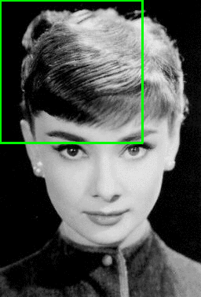
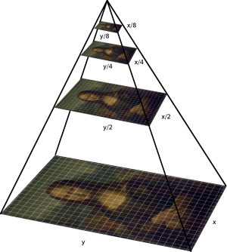
Pedestrian detection
Starting with the image’s original size, place the window in the top left corner and run the algorithm.
Slide the window (winStride pixels), and run the HOG on the next segment.
For each HOG, make a decision if the window contains a person
Scale the image (by scale factor) and start again
source: Rosebrock. pyimagesearch. [5]

Slide 13
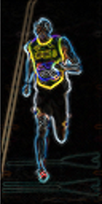
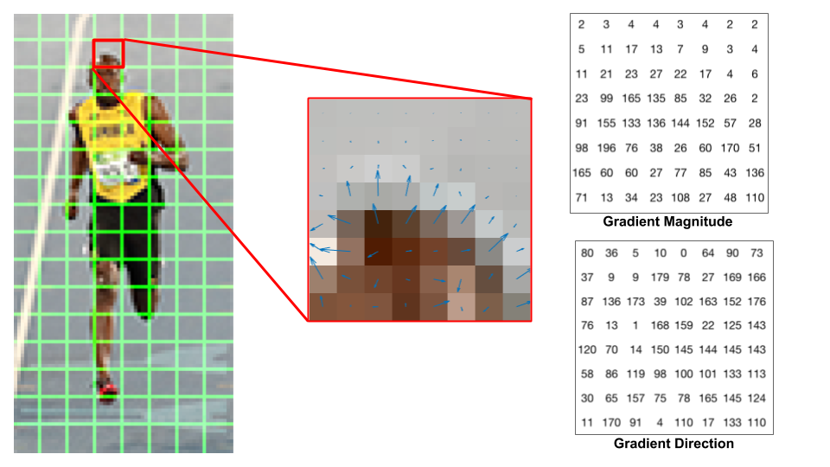
Feature descriptor (HOG)
Segment the image in patches (64x128)
Calculate the gradient (magnitude and angle)
Divide the patch in 8x8 cells
64
128
source: Mallick. learn OpenCV. [2]
source: Mallick. learn OpenCV. [2]

Slide 14
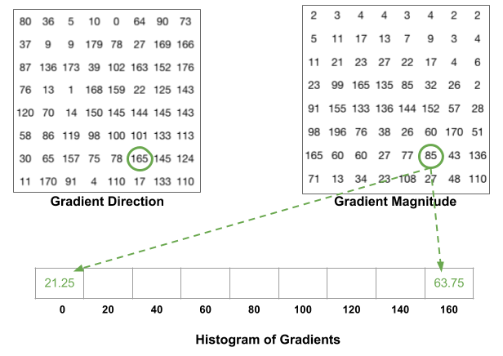
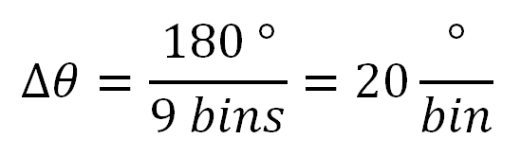

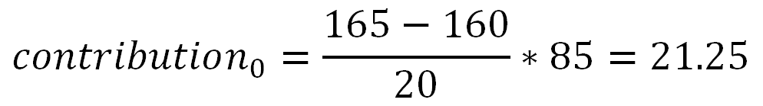
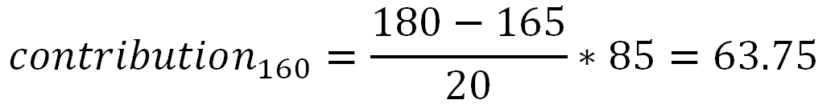
Feature descriptor (HOG)
Segment the image in patches (64x128)
Calculate the gradient (magnitude and angle)
Divide the patch in 8x8 cells
Build the histogram for each cell, using 9 angle bins (unsigned 0-180) and the magnitude as the distribution (contributing to 2 bins)
source: Mallick. learn OpenCV. [2]

Slide 15
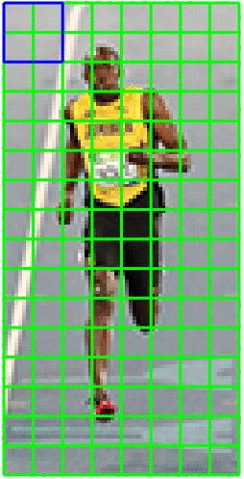
Feature descriptor (HOG)
Segment the image in patches (64x128)
Calculate the gradient (magnitude and angle)
Divide the patch in 8x8 cells
Build the histogram for each cell, using 9 angle bins and the magnitude as the distribution
Normalize the histograms in 16x16 blocks (4 contiguous cells)
Concatenate 4 histograms (36 bins)
Using L2 norm
Reduce lighting dependency.
source: Mallick. learn OpenCV. [2]

Slide 16
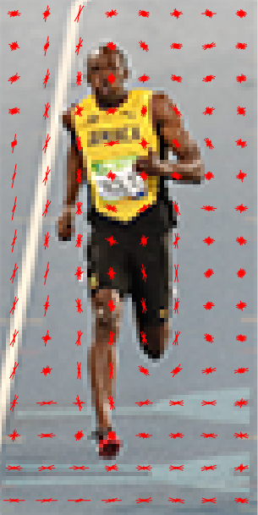
Feature descriptor (HOG)
Segment the image in patches (64x128)
Calculate the gradient (magnitude and angle)
Divide the patch in 8x8 cells
Build the histogram for each cell, using 9 angle bins and the magnitude as the distribution
Normalize the histograms in 16x16 blocks
Concatenate 36-bins vectors (histograms) from each block into a 3780 values.
7 horizontal positions
15 vertical positions
7x15x36 = 3780
source: Mallick. learn OpenCV. [2]

Slide 17
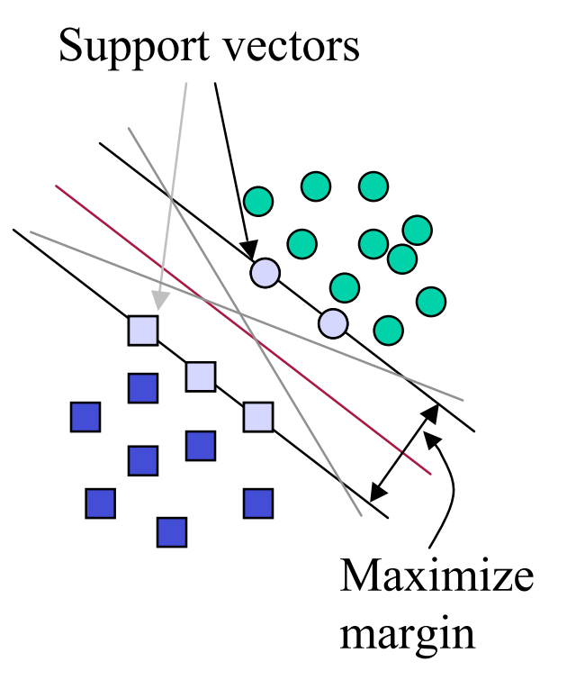
Support Vector Machine (SVM)
Supervised learning method for classification.
Closest points determine the hyperplane. (Support vectors)
Based on the resulting histogram, decide if it is a positive detection.
Trained with the INRIA person dataset.
3600 images
source: R. Berwick. MIT. [3]

Slide 18
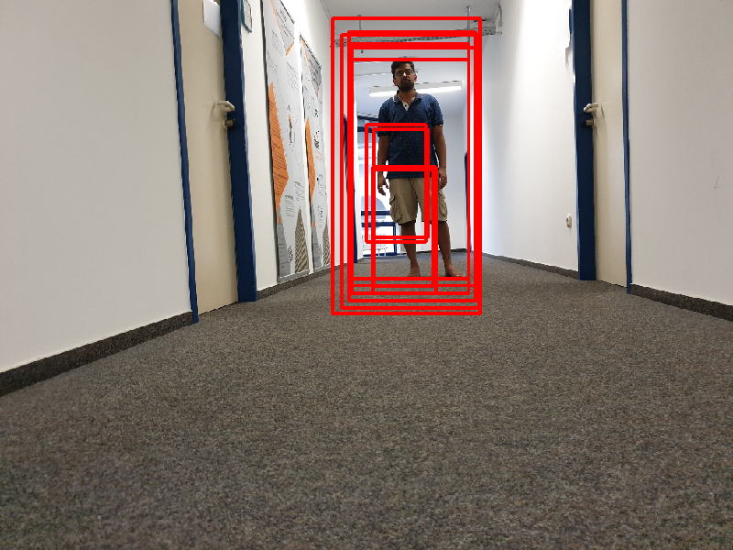
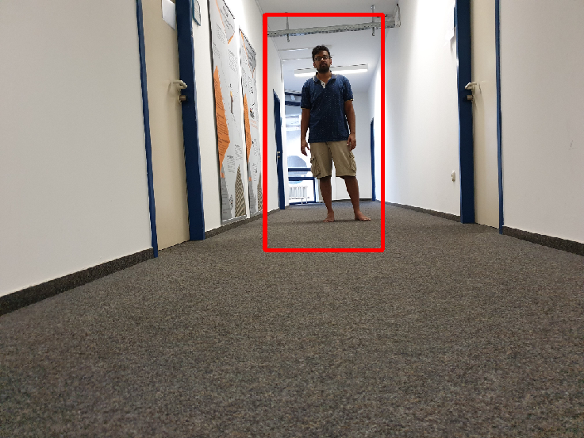
Non maximum suppression (NMS)
Transform many window hypothesis into a single box for each detected pedestrian
Resulting rectangles are the biggest in the overlapping region

Slide 19
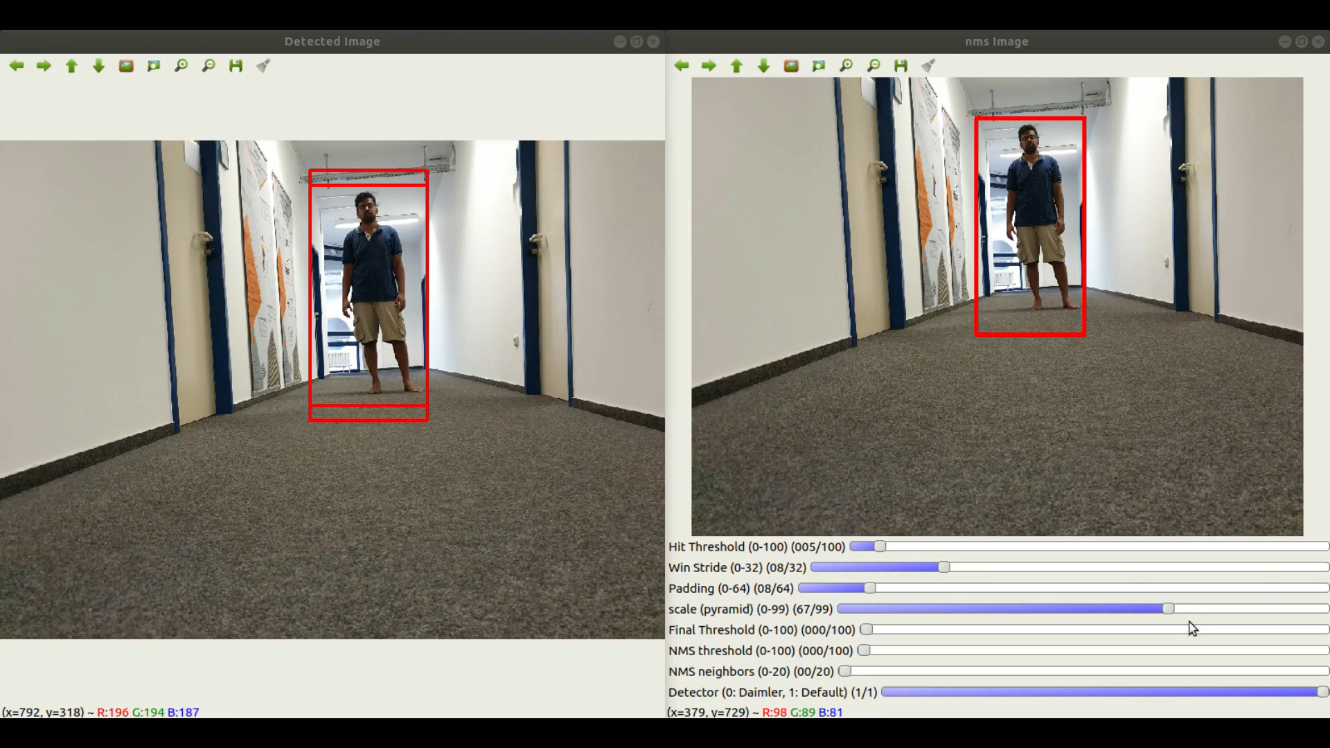
Algorithm:

Slide 20
Bibliography
Navneet Dalal, Bill Triggs. Histograms of Oriented Gradients for Human Detection. Cordelia Schmid and Stefano Soatto and Carlo Tomasi. International Conference on Computer Vision
Pattern Recognition (CVPR ’05), Jun 2005, San Diego, United States. IEEE Computer Society, 1, pp.886–893, 2005, <http://ieeexplore.ieee.org/xpls/abs_all.jsp?arnumber=1467360>.
<10.1109/CVPR.2005.177>. <inria-00548512>
Mallick, Satya. “Histogram of oriented gradients”. December 2016. Consulted in: https://www.learnopencv.com/histogram-of-oriented-gradients/
R. Berwick. “An idiot’s guide to Support Vector machines (SVMs)”. MIT. Consulted in: http://web.mit.edu/6.034/wwwbob/svm-notes-long-08.pdf
INRIA Person Dataset. Consulted in: http://pascal.inrialpes.fr/data/human/
Rosebrock, Adrian. HOG detectMultiScale parameters explained. November 2015: pyimagesearch. Consulted in: https://www.pyimagesearch.com/2015/11/16/hog-detectmultiscale-parameters-explained/

Slide 21
Future Scope of Work
Future Scope
Extended features
Multiple pedestrian detection
Multiple object detection – such as Animals, Vehicles, etc.
Multiple cameras for 360 degree field of view
Quality of camera to improve accuracy
Camera image stabilisation
Camera Mounting height, angle
Algorithms to explore
Histogram of Oriented Gradients (HOG)
Scale Invariant Feature Transform (SIFT)
Convolutional Neural Networks (CNNs)

Slide 22
Future Scope of Work
Future Scope cont…
Libraries
Tensor flow
PyTorch
mlpack
Speed improvement
FPGA
GPUs

Slide 23
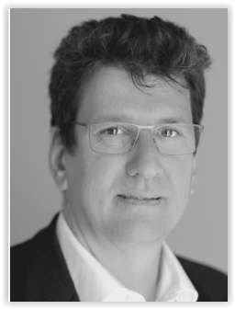
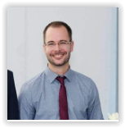
Supervisors
Prof. Dr. Peter Fromm
Course Director
IMSEIT, HDA
Mr. Thomas Barth
Teaching Fellow
HDA

Slide 24
Thank you!

